Slide 1
Microsoft Cognitive Services
Christina E. Leo
christina.leo@microsoft.com
13 August 2018

Slide 2










Why Microsoft Cognitive Services?
Easy
Flexible
Tested
Roll your own with REST APIs
Simple to add: just a few lines of code required
Integrate into the language and platform of your choice
Breadth of offerings helps you find the right API for your app
Bring your own data for your custom experience
Built by experts in their field from Microsoft Research, Bing, and Azure Machine Learning
Quality documentation, sample code, and community support
GET A KEY
BUILD

Slide 3







Microsoft Cognitive Services
Give your apps a human side
Vision
Speech
Language
Knowledge
Search
Labs
Computer Vision
Content Moderator
Face
Video Indexer*
Speech to Text*
Text to Speech*
Speech Translation*
Speaker Recognition*
Bing Spell Check
Translator Text
Text Analytics
Content Moderator
Linguistic Analysis*
Web Language Model*
QnA Maker
Bing News Search
Bing Video Search
Bing Web Search
Bing Autosuggest
Bing Entity Search
Bing Image Search
Bing Visual Search
Gesture
Personality Chat
Event Tracking
Academic Knowledge
Local Insights
Knowledge Exploration
Entity Linking
URL Preview
Answer Search
Anomaly Finder
Conversation Learner
CUSTOMIZATION
Custom Vision Service*
Custom Speech Service*
Language Understanding (LUIS)
Custom Decision Service*
Bing Custom Search
*Preview

Slide 4
Let’s look at some demos.

Slide 5





Sentiment over time in a business.
Text divisible over time
Identifiable ‘characters’
Ability to take action
Email and Chat Transcripts
Call Centre Transcripts
News and Social Media
New transcripts
New possibilities for action
New improved interactions
Education and learning
Bot interactions

Slide 6
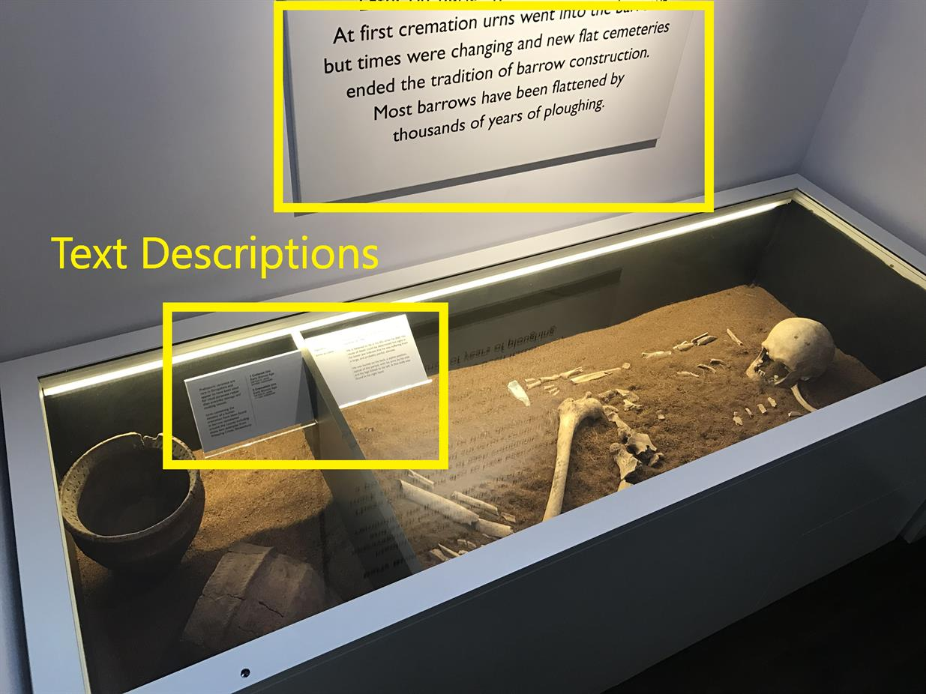
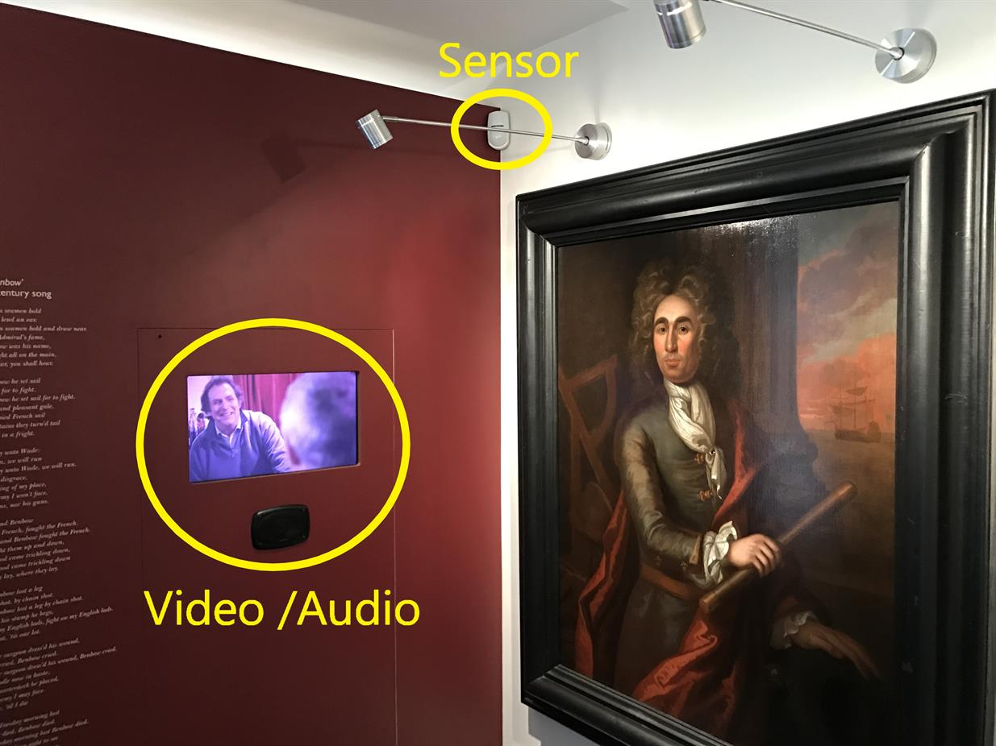




Black Radley and Shrewsbury Museum & Art Gallery…
Using Cognitive Services to make museum exhibits more compelling and track user behaviour
Track
Analyse
Understand
Improve

Slide 7
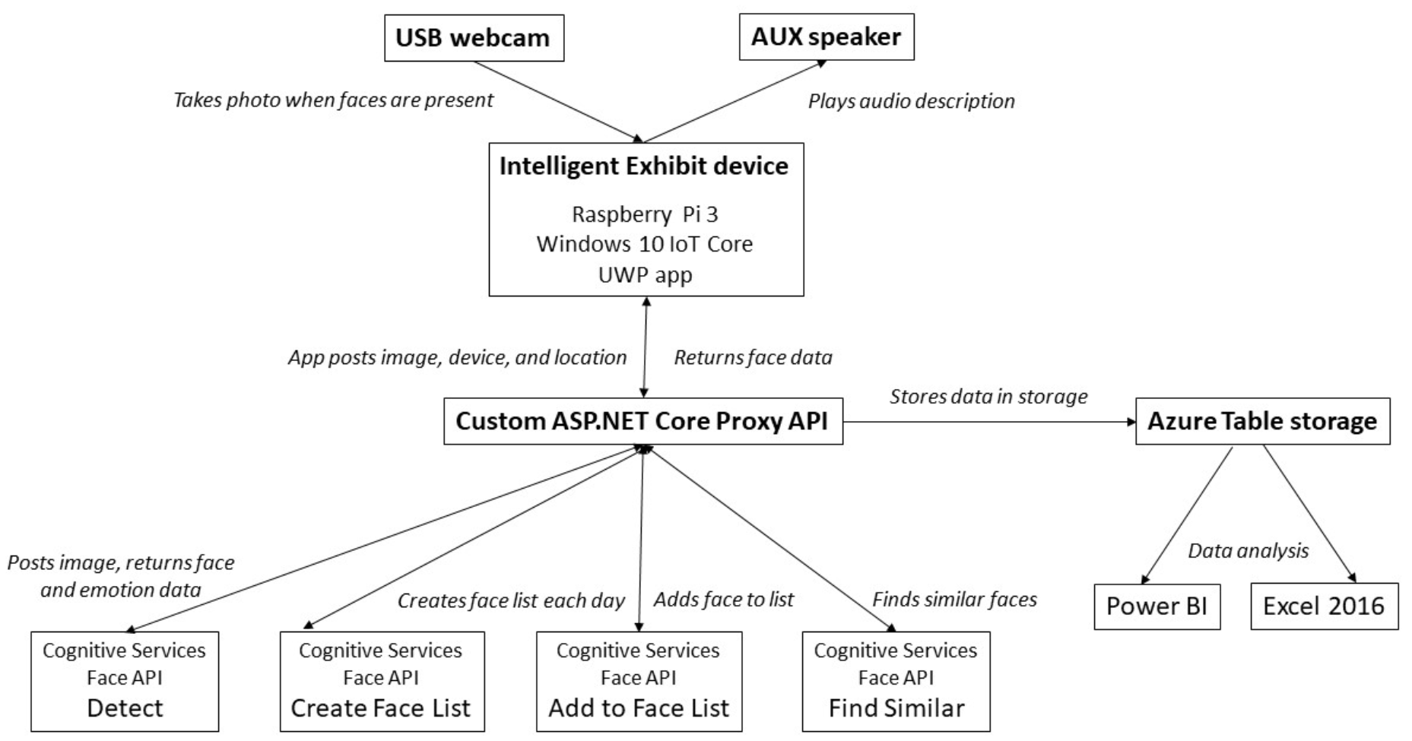
Build
Cognitive Services
Power BI
Notes:
Microsoft teamed up with Black Radley and the Shrewsbury Museum & Art Gallery to create a solution that would react to museum patrons as they interact with exhibits based upon their approximate age, gender, and emotional state. Additionally, the solution would provide detailed insight on how patrons traverse the museum, which exhibits they linger at, and for how long.
The goal was to address problems that museums face around making exhibits more compelling for patrons and better understand how patrons use the museums.

Slide 8
Using the Computer Vison API with Python
Custom Vision Classification Model
Find the code here:
https://github.com/christinaleo-msft/S2DS

